Slide 1
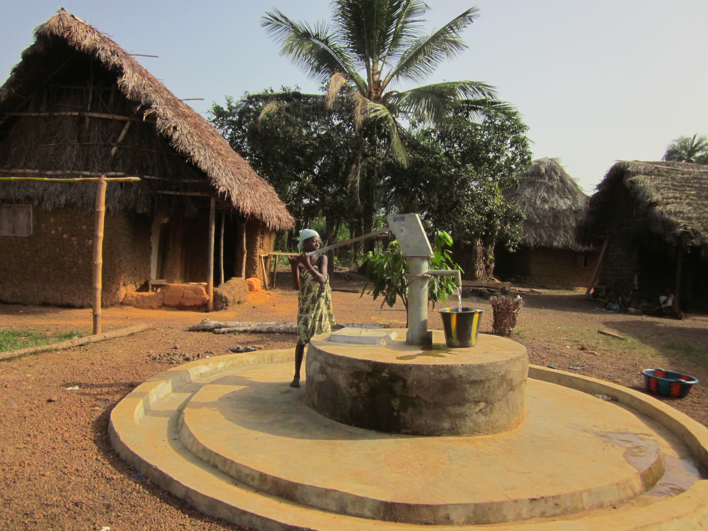

Slide 2
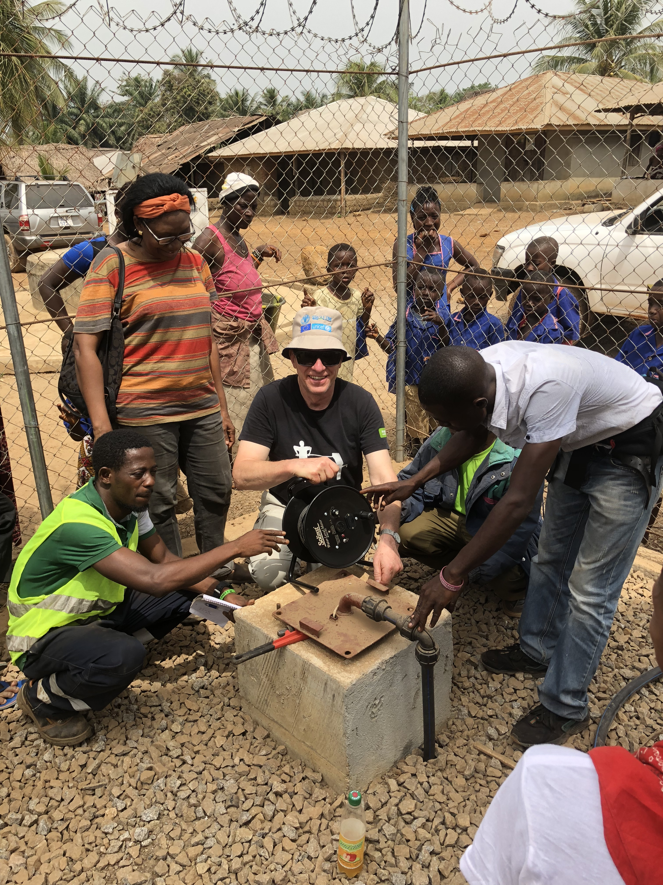
Building a better tomorrow
EWB-DK is a technical humanitarian organization establishing life-saving and sustainable measures for people in need and poverty and thereby supporting the UN Sustainable Development Goals.
Building a better tomorrow requires basic human rights to be present, so that diseases and epidemics can be avoided and basic conditions for a dignified life are provided.

Slide 3
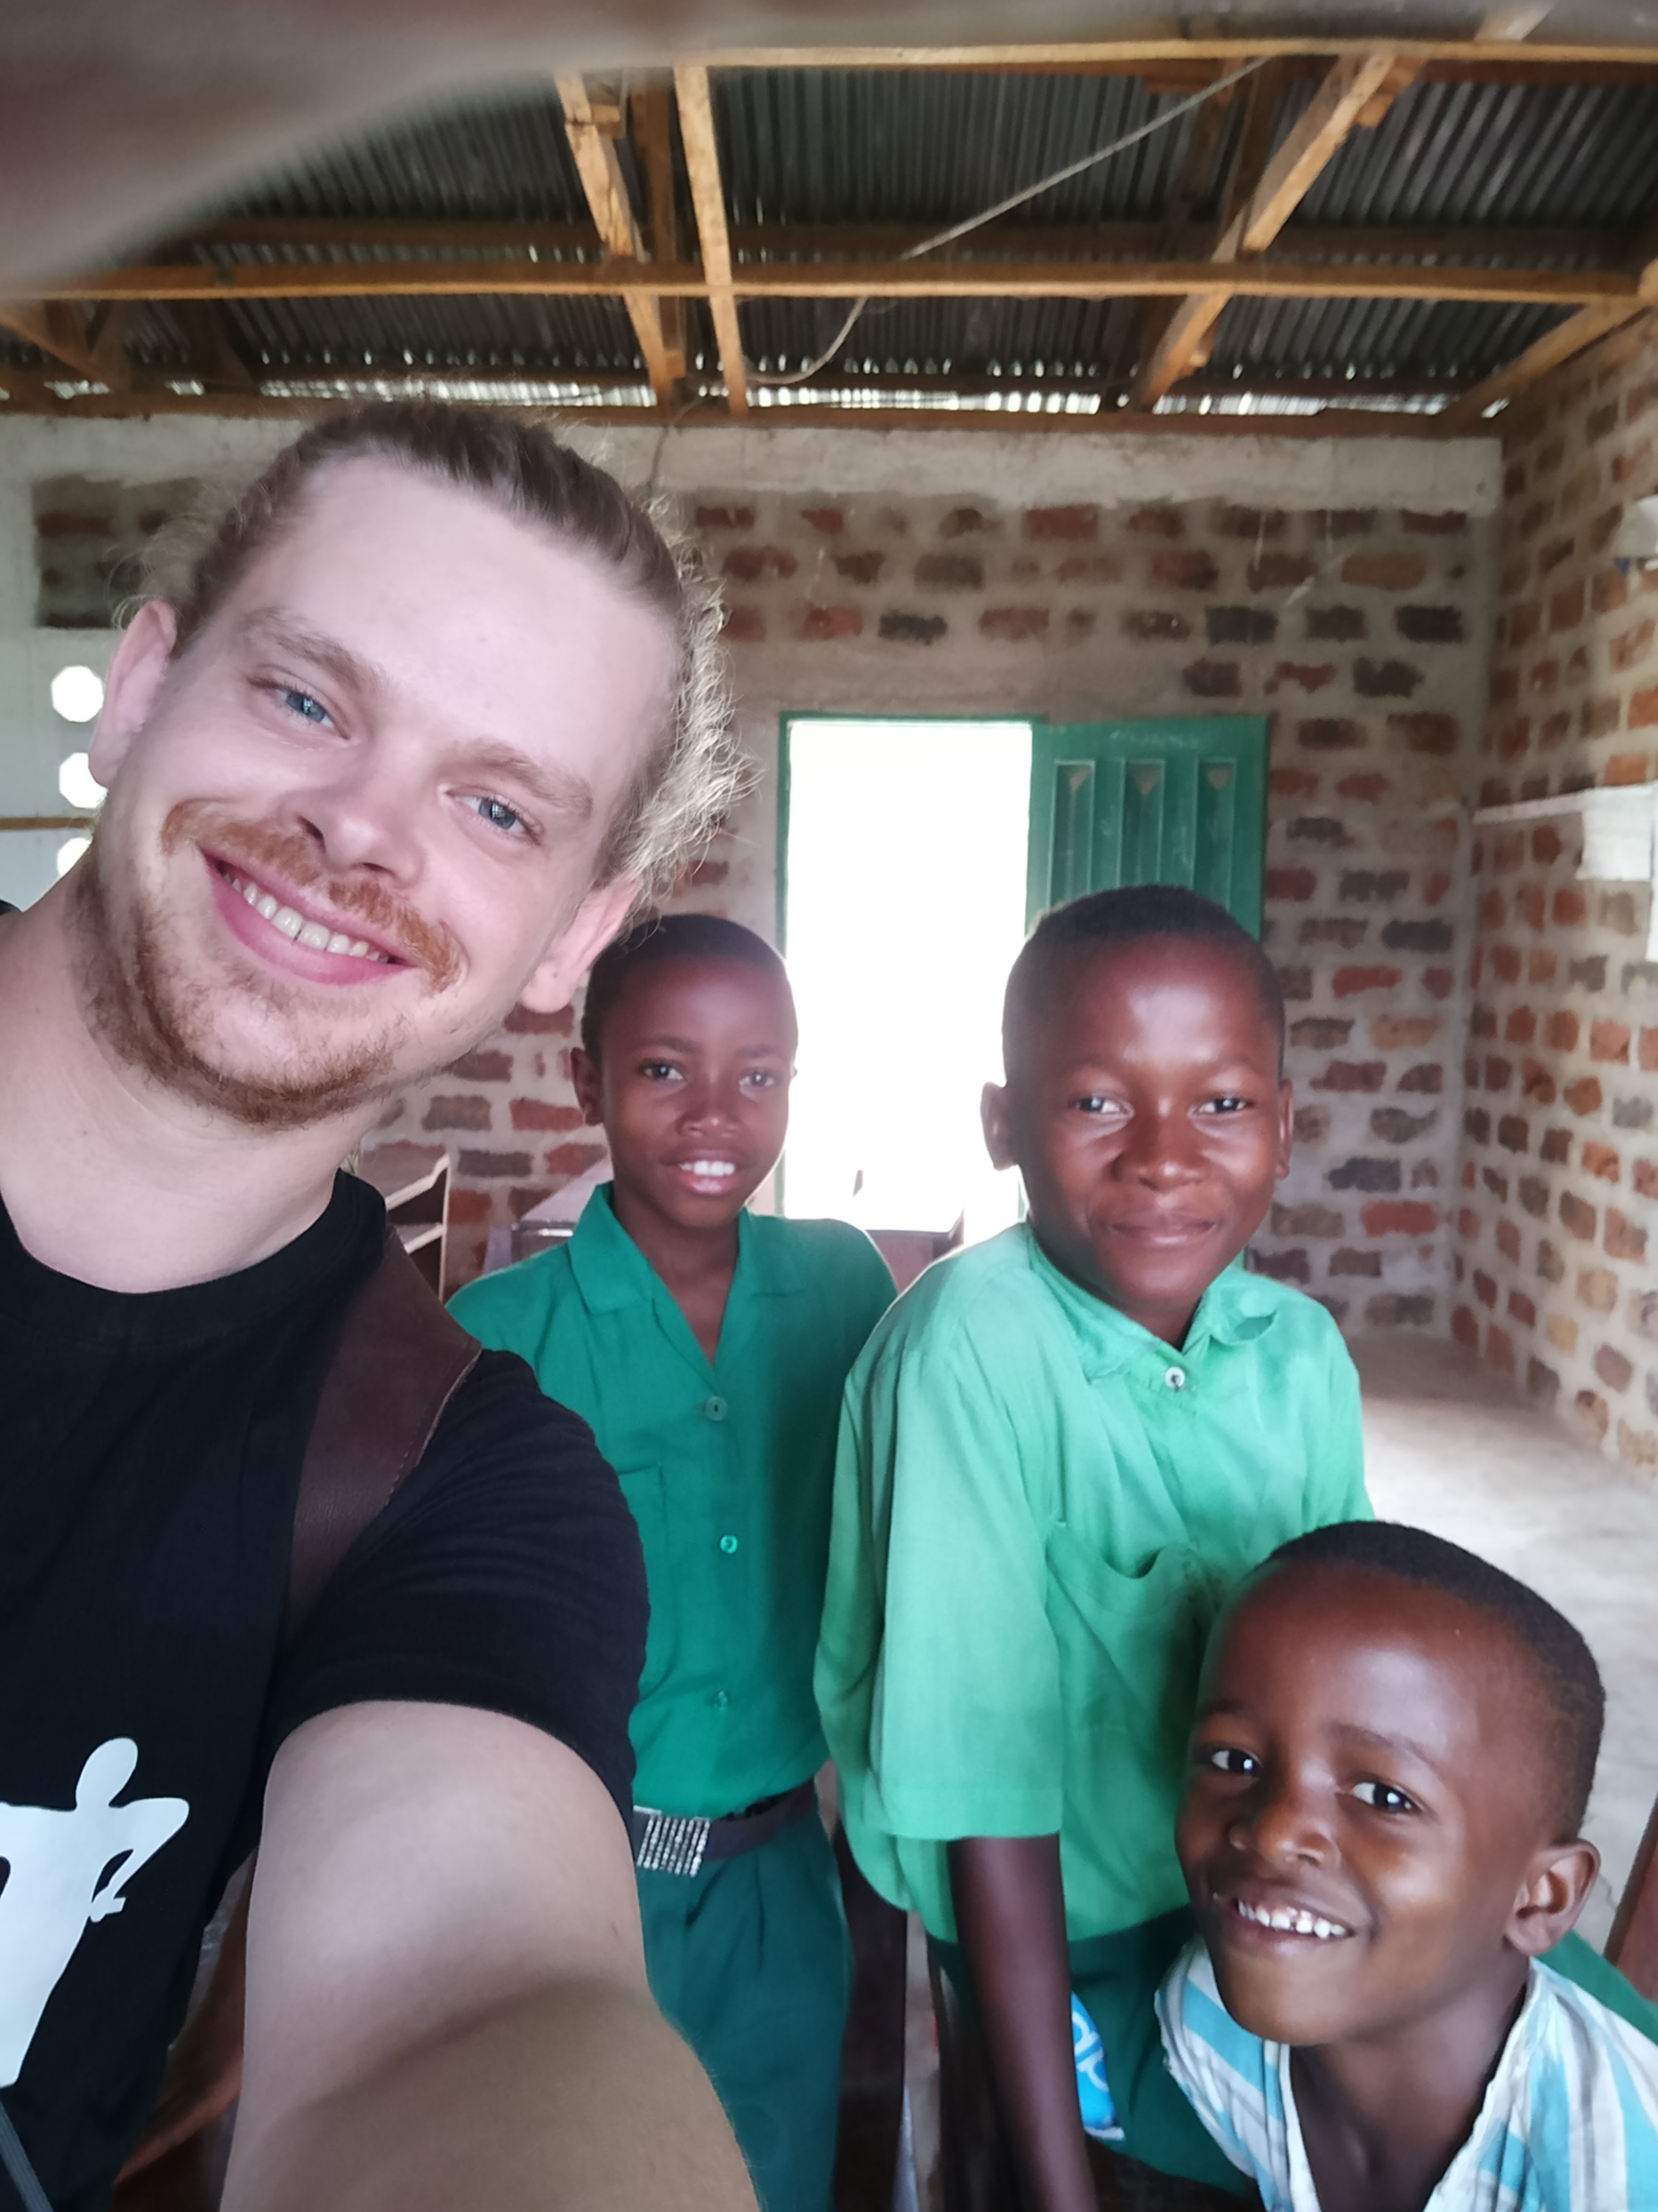
EWB-DK in numbers
Established in 2001
1,350+ members
250 active volunteers
Work through partners in south – current projects 15 /completed projects approx. 70 – 12.5 million DKK

Slide 4
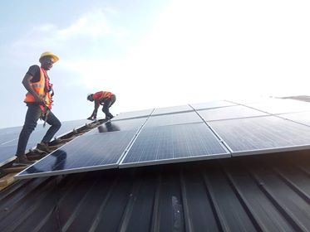
Our vision
EWB-DK works to develop strong and sustainable communities and to support development processes, based on equal and fair distribution of the world´s available resources.

Slide 5
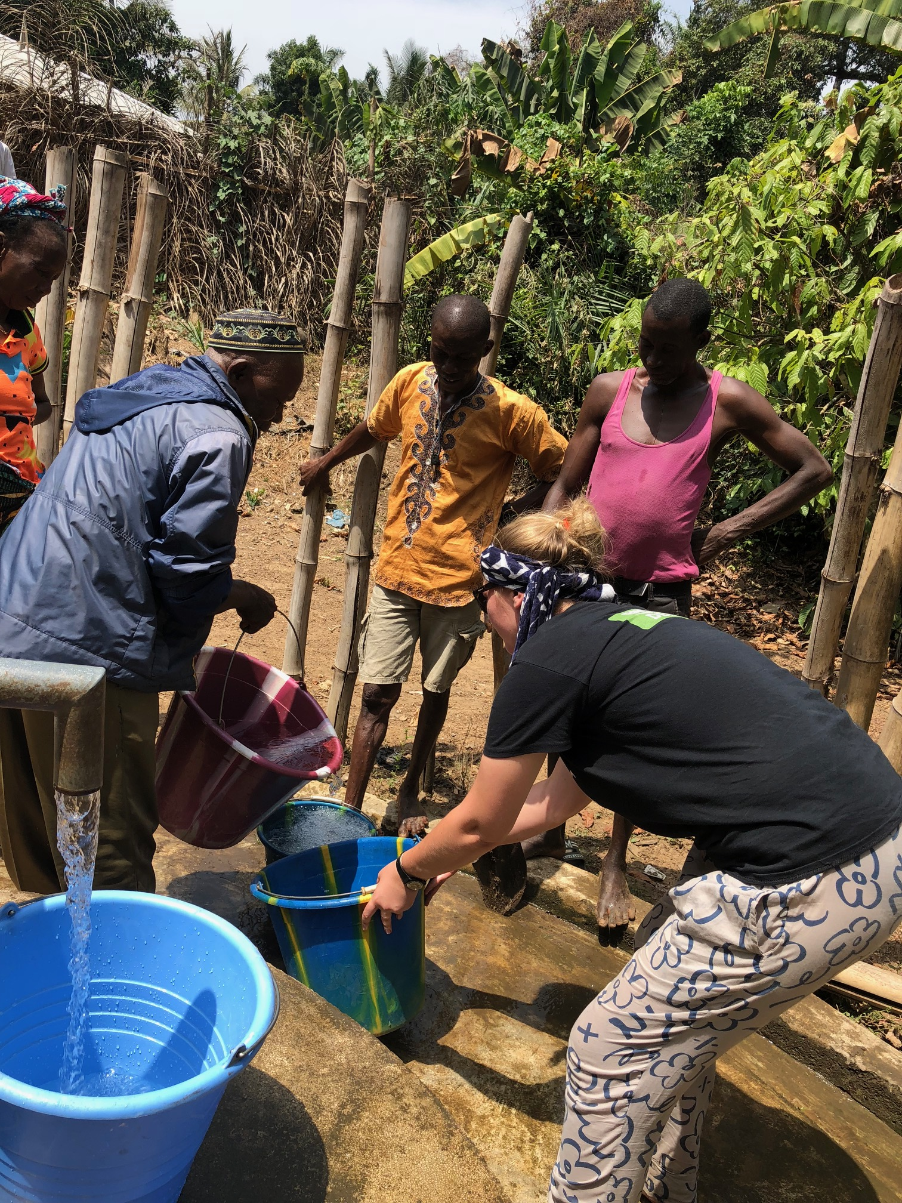
Our mission
To support vulnerable groups through technical, sustainable and local solutions.
To carry out development and relief work through the support of the Danish resource base.
To build knowledge and skills in our resource base to work in a global development context.

Slide 6
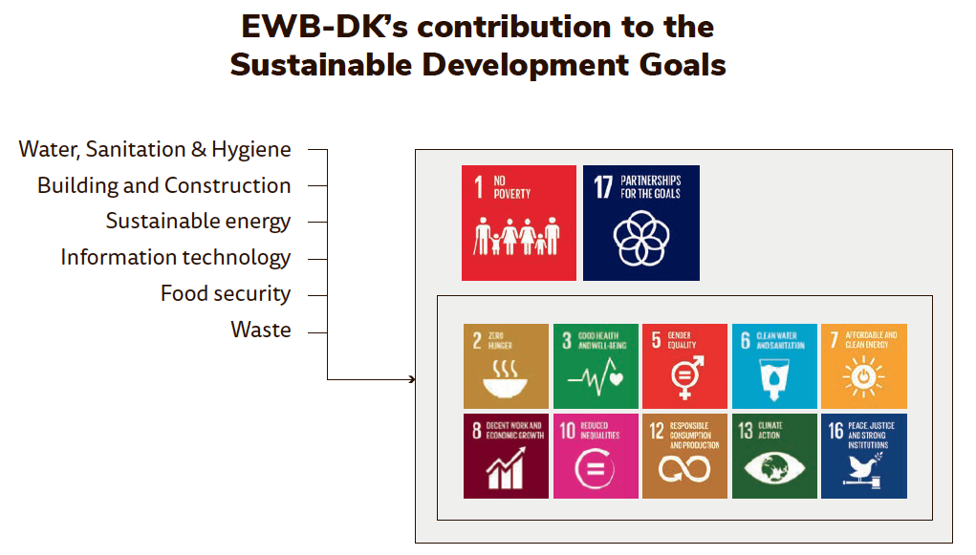
Strategic focus

Slide 7
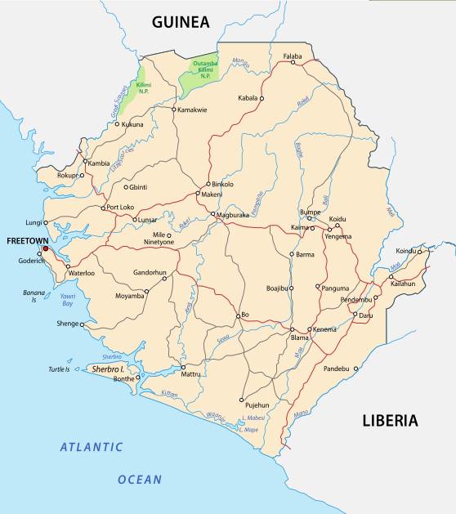
Sierra Leone in numbers
Area: 71,740 km2
Population: 7,813,207
Agricultural land: 56.2 %
Forest: 37.5 %
Electrification: 6 % of population
Electricity from fossil fuels: 33.3 %
Electricity from hydroelectric: 66.7 %
Roadways: 11,300 km
Paved roadways: 904 km

Slide 8
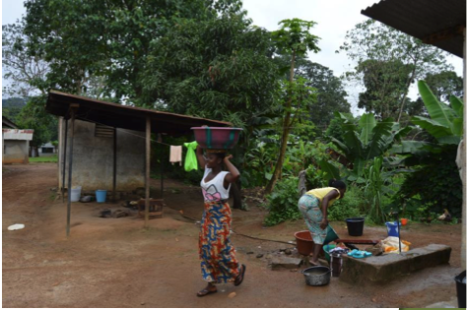
Extreme poverty and gender inequality
Sierra Leone is one of the poorest countries in the world, ranked as 182 of 188.
About 60 % of the population live under the poverty line, with a concentration in rural areas.
More than 40 % of the population has no access to potable water and about 60% do not have adequate sanitation.
Diarrhoeal diseases are among the three most occurring causes of death.
Significant gender-based inequalities in reproductive health, empowerment and economic activity.

Slide 9
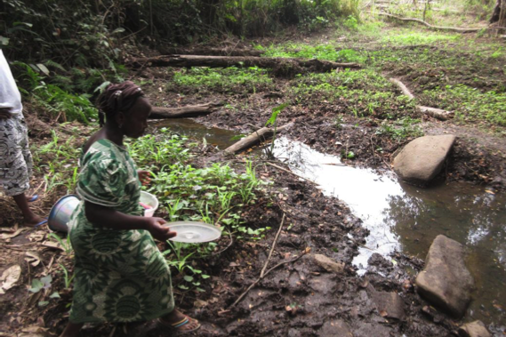
Environmental problems and vulnerability to climate change
Open defecation and unsustainable mining activities contributes to pollution of water resources.
Dependence on biomass based energy (80 % of the total) and rising demands from agribusiness results in massive deforestation (3,000 hectares a year) and increased risk of soil erosion and landslides.

Slide 10
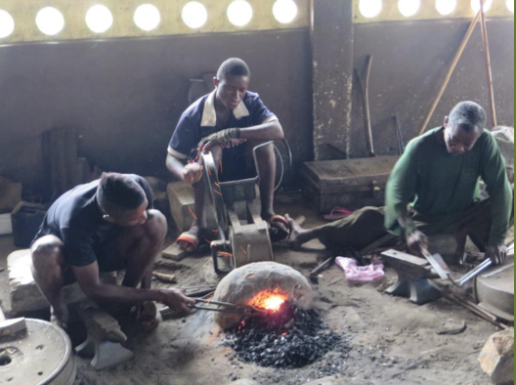
Unemployment and lack of technical skills
Youth unemployment rate of about 60 % is closely connected to high levels of illiteracy and unskilled labour, a lack of private sector jobs, and low pay.
The Ebola outbreak during 2014- 2015, combined with falling global commodities prices and the lack of technical and vocational skills inhibits economic growth.
Heavily dependent on foreign aid, with about 50 % of public investment programmes financed by external resources.

